Slide 1



Masryef Advisory
Islamic Fintech and Shariah Compliant Digital Solutions as Alternative to Islamic Banking
Global Islamic Fintech Forum 2024

Slide 2

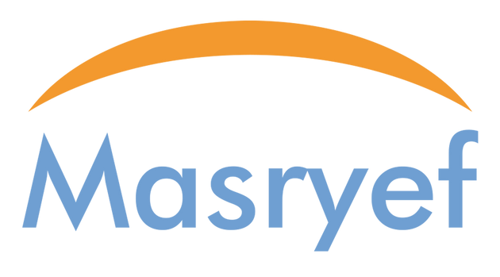
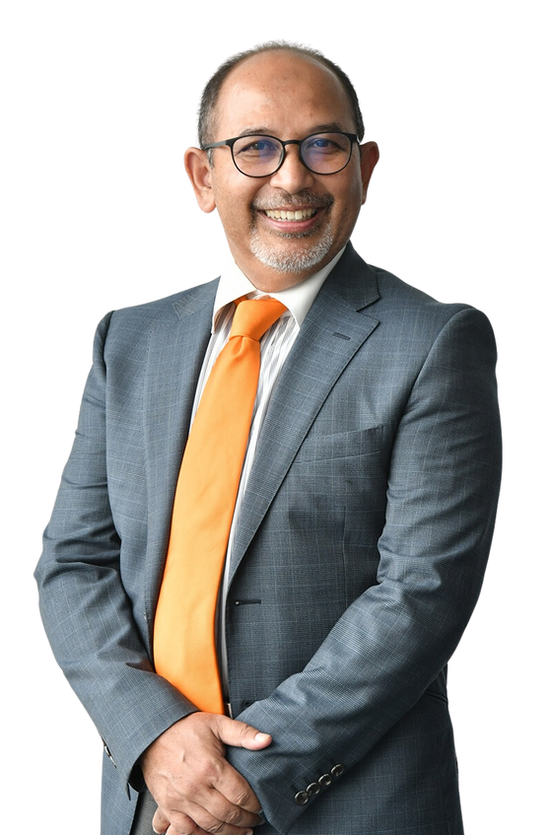


  Introduction
+30 years
of banking experience
Director of Masryef Advisory
Shariah Committee for Aeon Bank
Shariah Committee forAIA Takaful
  SVP, Head of Product and Structuring, Al Hilal Bank
  SVP, Wholesale Banking Products, Al Rajhi Bank
  HSBC Bank Malaysia Berhad
Khairil Anuar
Principal
MBA,
St Louis University
Bachelor of Science in Business Administration,
St Louis University
Masryef Advisory | 2024

Slide 3











































About Masryef
Leading Boutique Islamic finance advisory company based in Kuala Lumpur
Masryef has handled over +100 project involving global clients and various Islamic finance products
Registered
Shariah Advisor for:
Operate for +6 years
Shariah advisor to more than 70% of RMOs in Malaysia
Awarded for Best Islamic Finance Consultancy Firm at the IFN 2024 Awards.
Masryef Advisory | 2024

Slide 4





Masryef Key Engagements
Developed Sunline's
Islamic Digital Core Banking System.
Assisted Aeon Bank in securing a Digital Bank license.
Assess VentureTECH's readiness for Islamic Window Business and certified theit islamic products
Shariah Advisor for SeaMoney SFinancing-i
Shariah advisor for Paywatch, the biggest EWA platform in Malaysia
  Developed product capabilities for a leading Malaysian bank
Masryef Advisory | 2024

Slide 5
Fintech as Islamic Banking Alternatives
Masryef Advisory | 2024

Slide 6






The Need for Alternatives to Islamic Banking
Greater and Economical Outreach Through Technology
Regulatory and Technological Hurdles
69%
Shariah compliance varies significantly across jurisdictions, creating barriers to scalability and cross-border operations.
of rural populations in OIC countries underserved or without access
(1)
Due to legacy systems and regulatory constraints, many Islamic banks struggle in digital adoption and transformation
1.4 billion adults globally unbanked
but many having access to mobile phones
(1)
median age of 27
The Opportunity
The global Islamic fintech market is projected to grow at a CAGR of
reflecting the increasing adoption of technology-driven financial solutions)
OIC countries have a
with smartphone penetration over
75%
in Indonesia, Malaysia, and the UAE.
17.3% from 2022 to 2027,
(1)
(2)
(1) DinarStandard’s “Global Islamic Fintech Report 2023/24
(2) The Global Findex Database 2021: Financial Inclusion, Digital Payments, and Resilience in the Age of COVID-19
Masryef Advisory | 2024

Slide 7
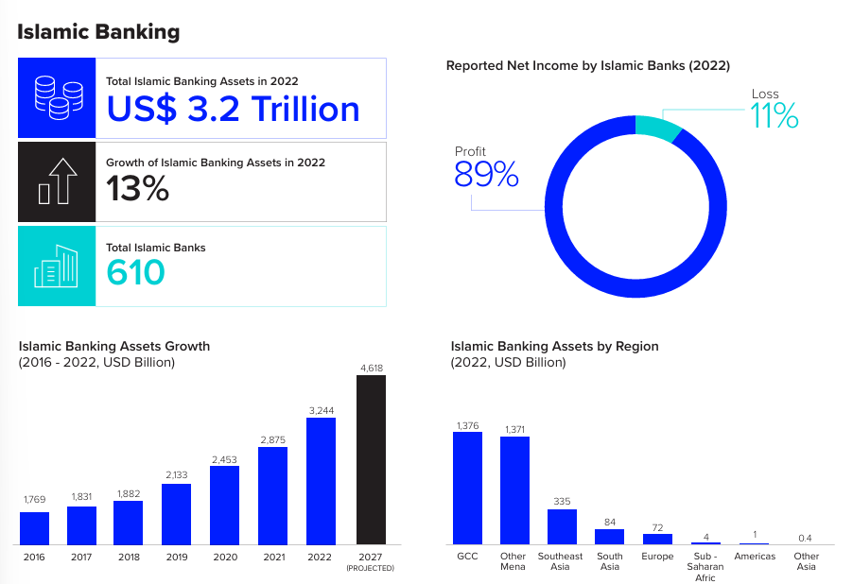
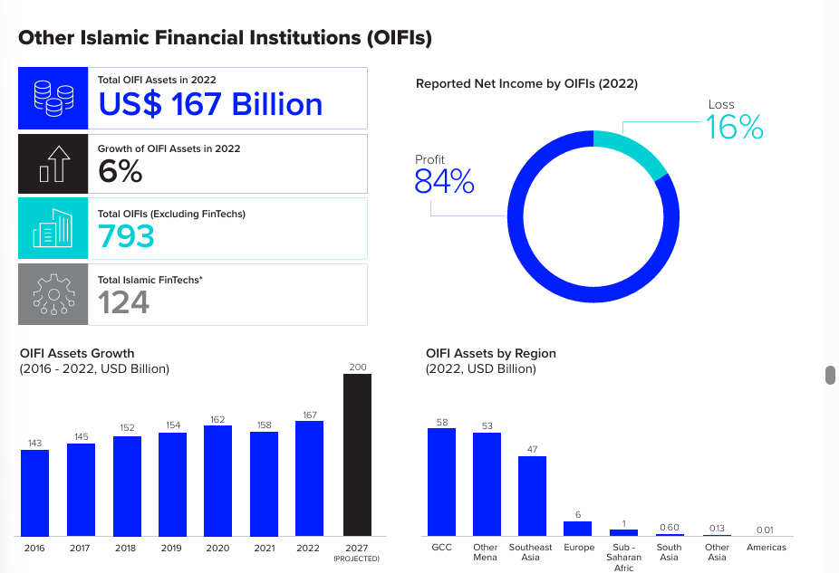
Islamic Banking Vs Other Islamic financial institutions (OIFI)
Islamic Banking
OIFI
FinTechs that provide Islamic financial services accounted for,
14% or 124 companies
of total OIFIs globally in 2022.
This highlights a substantial need for growth and expansion in the Islamic fintech sector
Masryef Advisory | 2024
ICD - LSEG ISLAMIC FINANCE DEVELOPMENT REPORT 2023

Slide 8
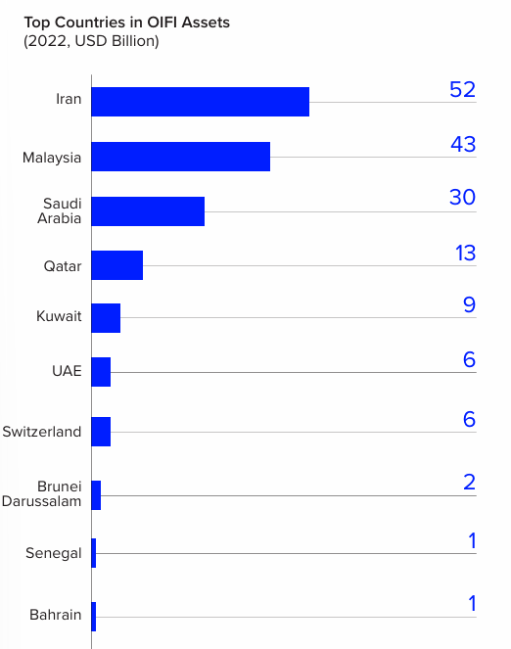

Initiatives and Strategies of Leading OIFI Country to Develop Islamic FinTech
Malaysia relying on FinTech to further develop its Islamic capital market and spur innovation
Launching FIKRA ACE, the regulator’s three-year Islamic Fintech accelerator programme.
Labuan FSA is also focusing on combining Islamic finance pillars with FinTech solutions through Digital Shariah governance. It aims to attract Islamic digital assets and FinTech players and infrastructure to Labuan
Masryef Advisory | 2024
ICD - LSEG ISLAMIC FINANCE DEVELOPMENT REPORT 2023

Slide 9





Islamic Digital Asset Centre (IDAC)
Launched in 2022, IDAC creates a digital market ecosystem, that promotes sustainable investment environment through real-world assets tokenization, all within Shariah-compliant framework
USD 10 tril market value Serving specifically 1.9 bil population
ISLAMIC DIGITAL CAPITAL MARKET
ISLAMIC DIGITAL FINANCIAL MARKET
ISLAMIC DIGITAL SOCIAL FINANCE
  Shariah-compliant Digital Exchanges
  Shariah-compliant Securities Token (RAMZ)
  Islamic digital banking - i-BOX
  Digital takaful / captives takaful
  Ummah-Linked Company
  Social digital wallet such as BIMP EAGA Wallet
Uphold Maqasid (objectives) Shariah
Powered by Shariah-compliant Blockchain Technology
Governed by Labuan Islamic Financial Services and Securities Act 2010
Masryef Advisory | 2024

Slide 10
  Islamic Fintech & Shariah Compliant Digital Solutions
Real-Case Study
Masryef Advisory | 2024

Slide 11

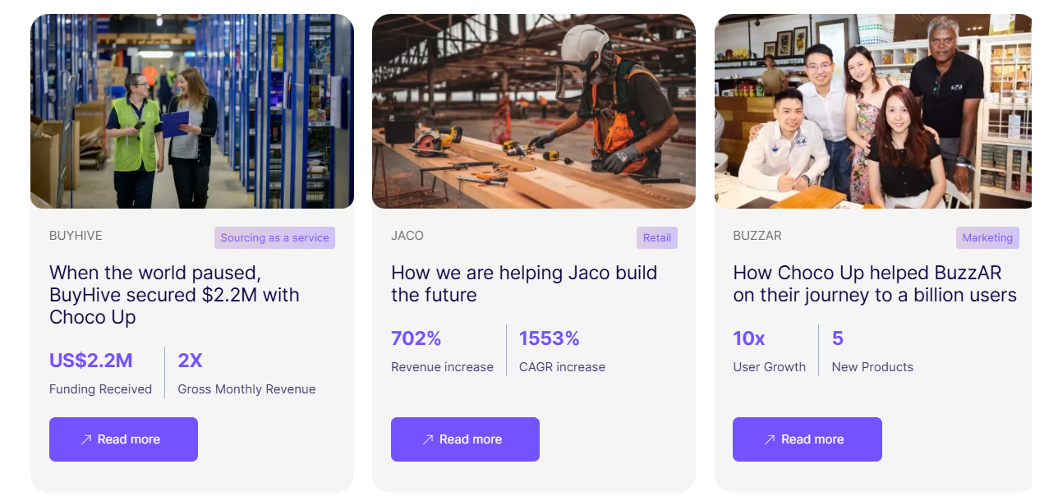
Case
Success Stories with Choco Up Financing
Revenue-Based Financi﻿ng
Choco Up empowers small businesses with flexible funding for expansion, inventory, or unexpected costs.
Instead of equity, Choco Up participates in clients' revenue.
A Wakala Investment structure was tailored for Choco Up.
Masryef Advisory | 2024

Slide 12
Choco Up vs. Traditional Funding Sources
Aspect | Choco Up's Revenue-Based Financing | Traditional Funding/Financing
Ownership Dilution | No equity taken; businesses retain full ownership. | May require giving up equity or ownership stakes, especially with venture capital or angel investments.
Repayment Structure | Flexible repayments based on a percentage of monthly revenue, aligning with business performance | Fixed repayments, regardless of business revenue, which can strain cash flow during low-revenue periods
Application Process | Streamlined, 100% online application with quick approvals, sometimes within 24 hours. | Lengthy and complex application processes, with approvals taking weeks to months.
Funding Amounts | Offers funding up to $100,000 for small businesses and SMEs. | Funding amounts vary widely; larger amounts may require extensive documentation and higher scrutiny.
Use of Funds | Flexible use of funds for various business needs, including expansion, inventory, and unexpected costs. | Use of funds may be restricted based on loan terms and lender requirements.

Slide 13
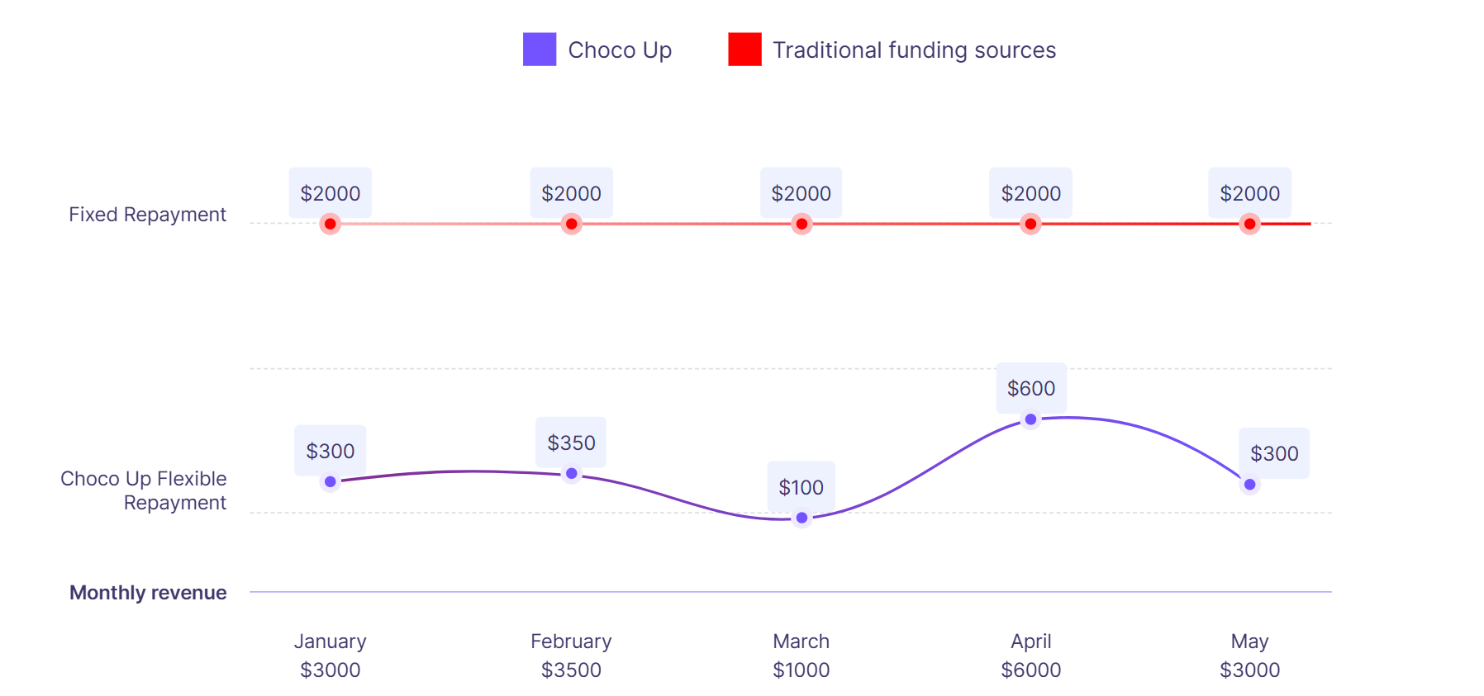
Choco Up vs. Traditional Funding Sources (illustration)
Traditional funding sources: Pay a fixed sum of $2,000 monthly.
Choco Up: Flexible payment of 10% of client’s monthly revenue .
$4500
$1500
$1700
$1500
$800
$15,000
$17,000
$8,000
$45,000
$15,000

Slide 14


Wakalah (Agency) Agreement
ChocoUp and the Entrepreneur enter into Agency Agreement.
1
Funds from ChocoUp are managed by the Entrepreneur in the business venture according to the objectives of the agreement.
2
Entrepreneur
3
The Entrepreneur pays ChocoUp monthly from the business revenue until the agreed-upon amount is fulfilled
ChocoUp
BROKER A
(BUYER)
Masryef Advisory | 2024

Slide 15
Wakalah (Agency) Agreement. Cont
  ChocoUp study and understand the Cash flow and feasibility of the Entrepreneur’s business.
  ChocoUp will ensure a mechanism is in place to digitally monitor the sale and collection of the Entrepreneur’s business.
  ChocoUp to put in place a mechanism to capture daily sale and capture an agreed percentage of daily sale towards “repayment pot”
ChocoUp
ChocoUp’s
  Role
BROKER A
(BUYER)
Masryef Advisory | 2024

Slide 16

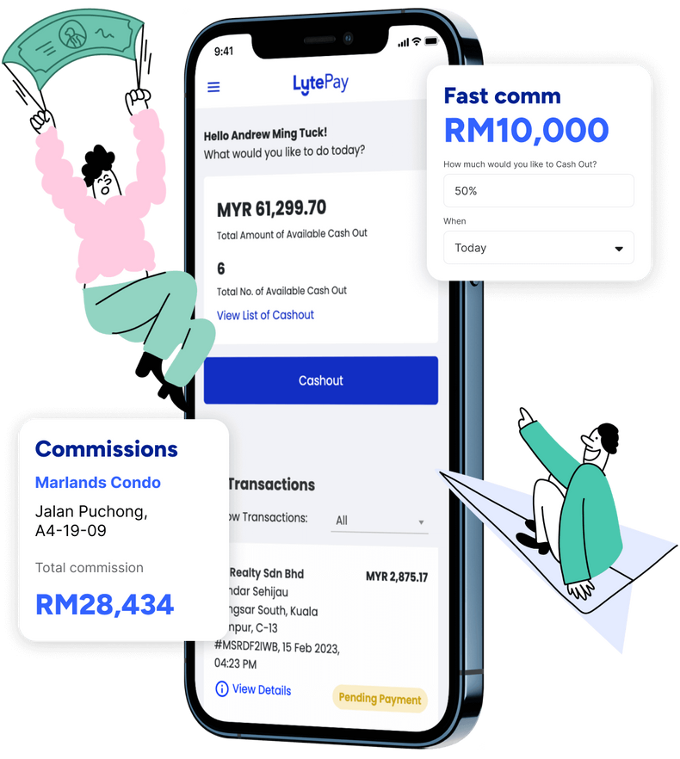
Case
Lyte enables influencers to access their commission in advance, bypassing typical client payment delays of 3 to 6 months.
Financing services - Commission based
Masryef Advisory | 2024

Slide 17


Influencer Financing Arrangement
Client
Influencer
  After successfully producing content, Influencer A is entitled to a commission or fee
2. Influencer usually receive payment from the clients within 3 to 6 months.
Lyte
3. The Influencer will request their commission through Lyte.
4. Lyte will provide the commission upfront, and the Client will repay Lyte after receiving the payment from the client.

Slide 18



Lyte targets trendy and tech-savvy segments that often overlooked by traditional banks.
Commission Advances for Influencers
Commission Advances for Property Agents
Factoring for Freelancers
Masryef Advisory | 2024

Slide 19
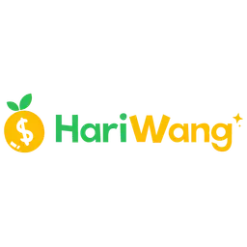
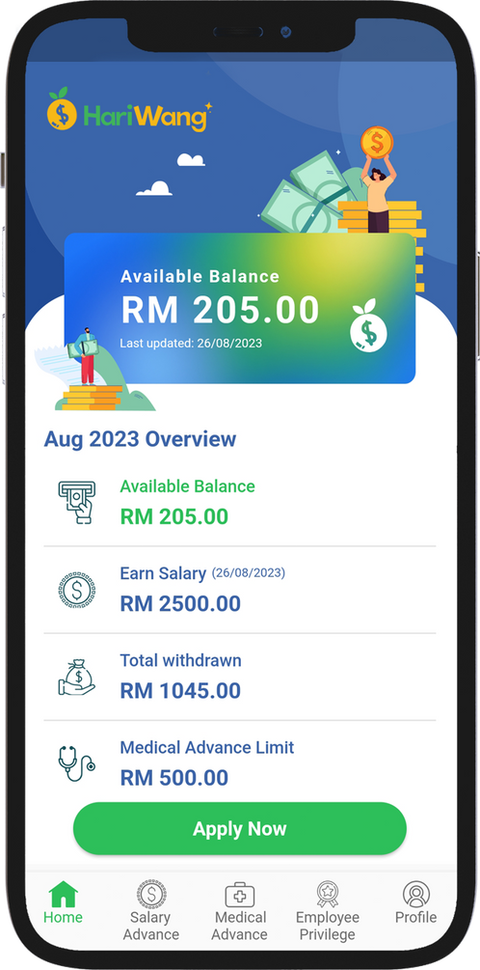
Case
Earned Wage Access (EWA)
01
02
EWA is a service that enables a Company's employee to request for a portion of the salary to be paid in advance.
This payment is applicable
on the portion of the employee’s salary that he has already been earned
Masryef Advisory | 2024

Slide 20





EWA Benefits Beyond Financial Access: Promoting Well-being and Flexibility
Improved Financial Wellness
Reduced Reliance on Predatory Lending
Timely Financial Support for Emergencies
Budgeting and Spending Insights
EWA helps users avoid costly credit options by enabling them to use their own earned money when needed, fostering better financial health
Users with access to EWA are less likely to resort to payday loans or credit cards with high-interest rates, as they can meet expenses by accessing their own earned income
users can access funds instantly in case of emergencies, giving them peace of mind and financial security in unexpected situations.
The platform provides insights of user’s spending patterns and withdrawal history, allowing them to budget effectively and improve financial planning.

Slide 21



EWA Model
Wakalah & Qard Arrangement
6
Company makes outstanding payment to HariWang​ RM500​
1
HariWang entered into an agreement with the Company to provide identified services to Company ’Salary Advancement​’
HariWang
Company
HariWang approves the withdrawal request​
4
3
HariWang verifies the details of Employee & work attendance
Employee sends withdrawal request​
RM500 (example) on the app​
2
HariWang Apps
(Portal)
5
The approved amount credited to the Employee’s account, less Withdrawal Fee:​
RM500 – R5 = RM495​
Employee
Masryef Advisory | 2024

Slide 22

Case
Southeast Asia’s largest SME Digital Financing platform.
01
02
Connecting SMEs with investors through an online marketplace to increase financing access for SMEs
  Multiple products:
  Micro financing-i
  Term Financing-i
  Invoice financing-i
Masryef Advisory | 2024

Slide 23
Funding Societies Vs Traditional Banking
Aspect | Funding Societies | Traditional Banking
Target Audience | SMEs, startups, and businesses with limited credit history. | more into established businesses with strong credit history and financial stability.
Transparency | Transparent platform with detailed information for both borrowers and investors, including project risk and returns | Limited transparency; borrowers and customers may not have full visibility into internal funding processes.
Funding Speed | Quick disbursement, typically within a few days | Slow disbursement; can take weeks after approval.
Application Process | Simplified online application; approval can take as little as a few days. | Lengthy application process with extensive documentation; approval can take weeks or months.
Investor Involvement | Crowdfunding model connects SMEs with a pool of individual and institutional investors | Funded directly by the bank, without external investor involvement.

Slide 24
P2P - Islamic TermFinancing via Commodity Murabahah
Transfer the payment
8
Onboard Platform
1
Onboard Platform
Principal
+ Profit
1
9
2
Issue Purchase Request
5
Sell at cost plus profit on deferred payment basis
Investor
Issuer
Payment on the spot
7
6
Sell comodity
Purchase commodity
Payment on Spot
3
4
BROKER B
BROKER A

Slide 25


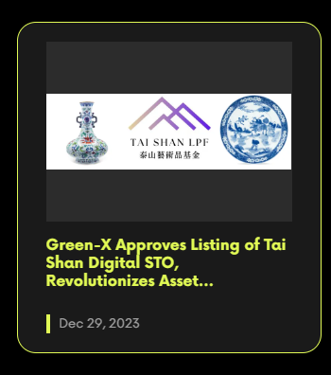

Case
Tai Shan Digital (TS1)
Tai Shan is an affiliate of a leading Chinese arts collector and dealer.
Tokenized Ordinary Shares
TS1 Token
Tai Shan intends to raise funds up to U.S.$65,000,000 via a new issue of Tokenized Ordinary Shares with a par value and issue price of US$1.00 per share.
Masryef Advisory | 2024

Slide 26
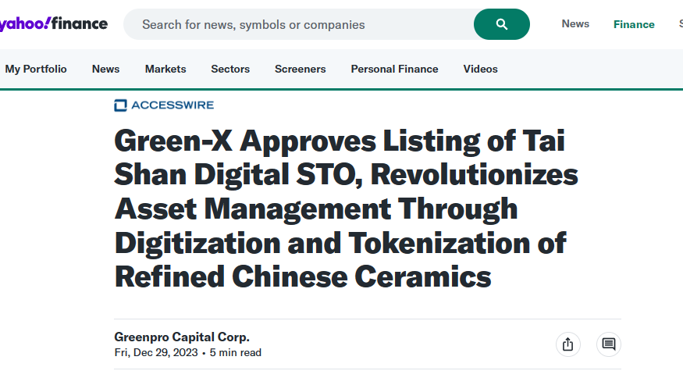
Case
Tai Shan Digital
Tokenized Ordinary Shares
TS1 Token
Masryef Advisory | 2024

Slide 27
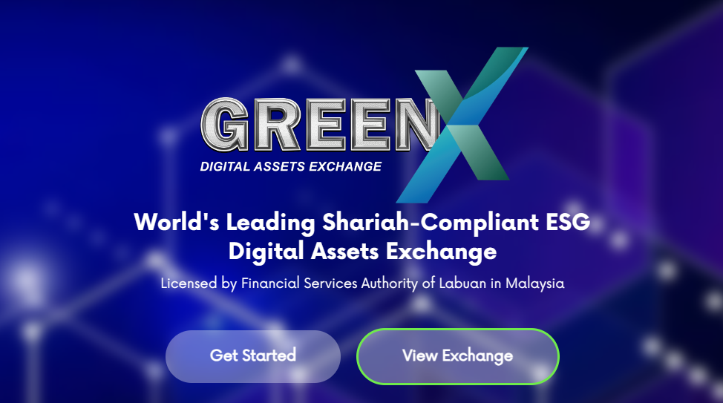
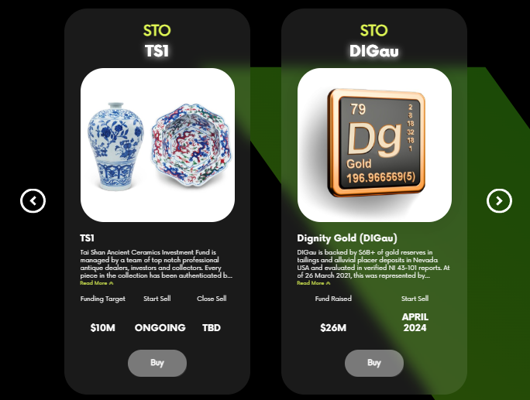
Islamic
Digital
Exchange
Security Token Marketplace
As Asia's leading trading platform for digital securities. We connect you with eligible assets based on your qualifications and enforce relevant regulations automatically with every trade.
  Buy and sell security tokens with protection
  All listed offerings approved by LFSA
Masryef Advisory | 2024

Slide 28



Joint Partnership
Agreement
the Joint partnership between all Investors and Tai Shan Management Limited.
1
1
2
Appointment of TSM as agent
5
Dividend is shared by TS1LPF with all Token holders/Shareholder
Token can be exchanged at GreenX platform
Security Token
Investors
3
TSM as Agent invests the proceed from Joint Partnership to subscribe to TS1LPF.
Tai Shan
Investment Manager
Master Fund
TS1LPF invests into artworks and ceramics
4
Tai Shan Token
Joint partnership & investment agency.
Art Portfolio
Masryef Advisory | 2024

Slide 29
The Key Takeaways
Masryef Advisory | 2024

Slide 30
Key Takeways
Technology expands access to underserved markets.
Technology fosters seamless connections between users and investors.
01
04
Technology drives innovative value creation
Technology strengthens risk management processes.
02
05
Technology fosters seamless connections between users and investors.
Technology powers instant, round-the-clock transactions.
03
06
Masryef Advisory | 2024
ICD - LSEG ISLAMIC FINANCE DEVELOPMENT REPORT 2023

Slide 31

Thank You
Masryef Advisory | 2024

Slide 32

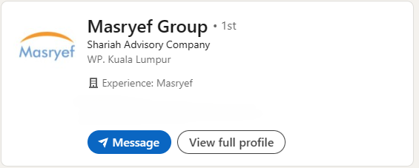

Connect with us
on Linkedin
Masryef Advisory Sdn Bhd
www.masryef.com

